Slide 1

Performance Analysis with Hatchet
12 April 2021
Olga Pearce, Stephanie Brink,
Abhinav Bhatele (Univ of Maryland), Todd Gamblin

Slide 2
Getting Hatchet Tutorial Materials
The SPOT container includes a sample Jupyter notebook, Hatchet v1.3.0 install, and Lulesh datasets.
Alternatively, the sample Jupyter notebook and the Lulesh datasets are available directly at https://github.com/llnl/spotbe. This will require you to setup your own environment with a caliper and hatchet install (and setup the paths accordingly in the notebook)!
Following this tutorial, you can substitute your own SPOT/Caliper data files into the example notebook.
We’ll use this material in the hands-on portion of the tutorial.

Slide 3
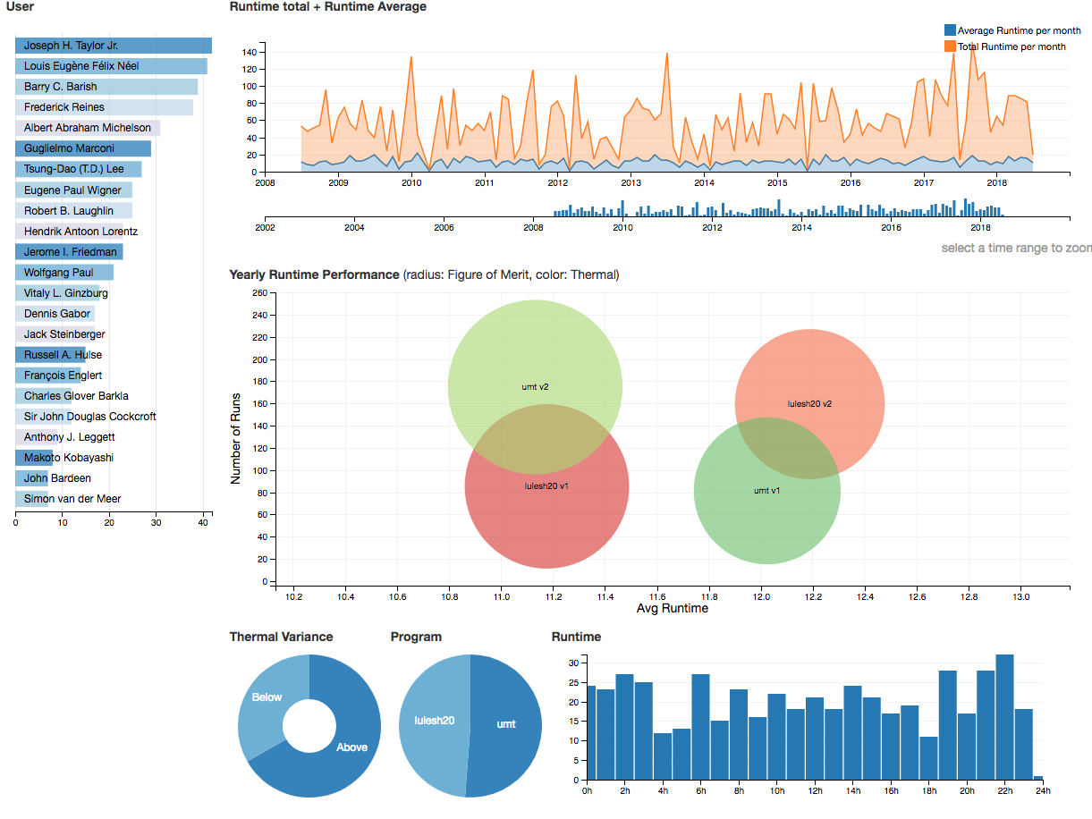

Automated Application Performance Analysis: Caliper → SPOT → Hatchet
#include <caliper/cali.h>
static inline
void LagrangeElements(Domain& domain, Index_t numElem)
{
CALI_CXX_MARK_FUNCTION;
// ...
Caliper instrumentation
in the application
At runtime: Performance and Metadata Collection
Analyze caliper datasets
in Python
Web-based Visualization and Analysis Tools
SPOT and Hatchet
c/o D Boehme
*Hatchet can analyze other datasets (HPCToolkit, gprof, TAU (WIP), Ascent (WIP))
Notes:
Tools and workflows for automatic profile collection
Work in progress

Slide 4
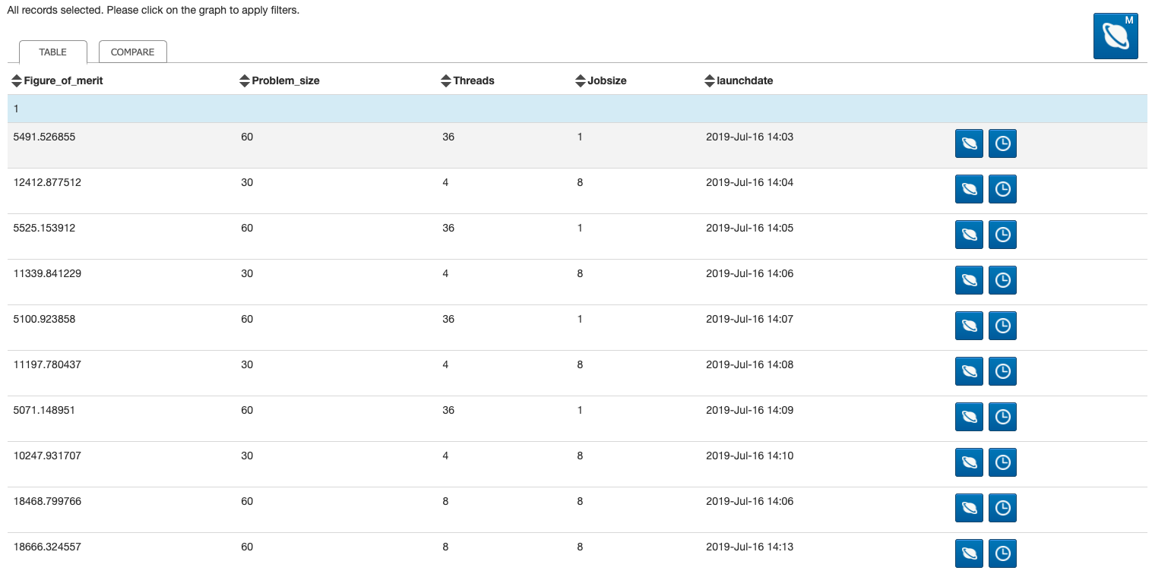
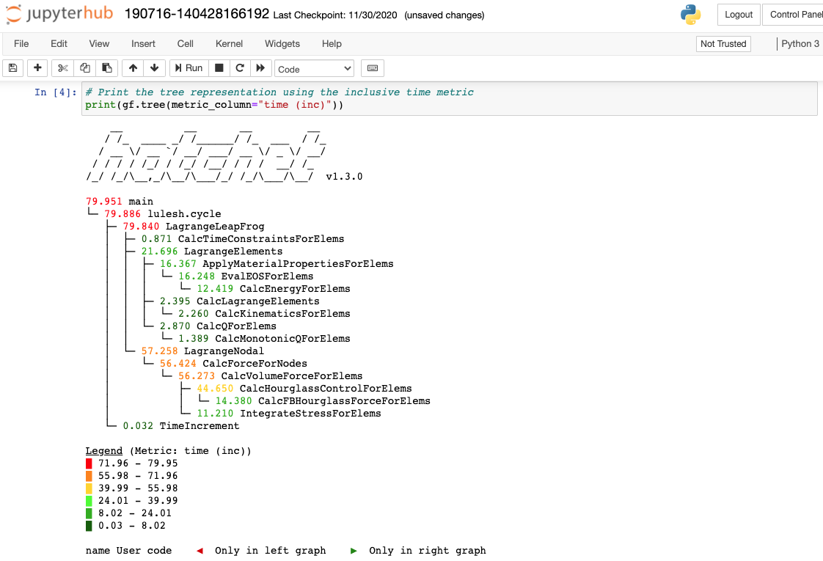
SPOT Web Interface: Run Table and Jupyter Notebooks
Buttons bring up Jupyter notebook or specialized analysis views
Jupyter notebook contains Hatchet functions
c/o D Boehme

Slide 5

Hatchet is a performance analysis tool for parallel profiles
Identify performance bottlenecks to enhance application development
Profiling and tracing tools (e.g., Caliper, HPCToolkit, TAU, Score-P, Gprof, Callgrind) provide insights into parts of the code that consume the most time
Hatchet is an open-source python-based tool for enabling programmatic analysis of structured (or hierarchical) data
Hatchet can be used to sub-select and focus on a specific region of the data, compare multiple execution profiles, and automate analysis in python scripts
https://github.com/hatchet/hatchet/

Slide 6
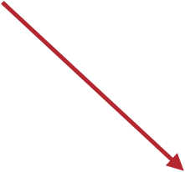
What do profiling/tracing tools collect?
Each node may contain:
Contextual Info
File
Line number
Function name
Callpath
Load module
Rank ID
Thread ID
Performance Metrics
Time
Flops
Cache misses
Hatchet can read profiles from:
Caliper
HPCToolkit
Gprof
TAU (WIP)
Ascent (WIP)
Calling Context Tree (CCT)

Slide 7

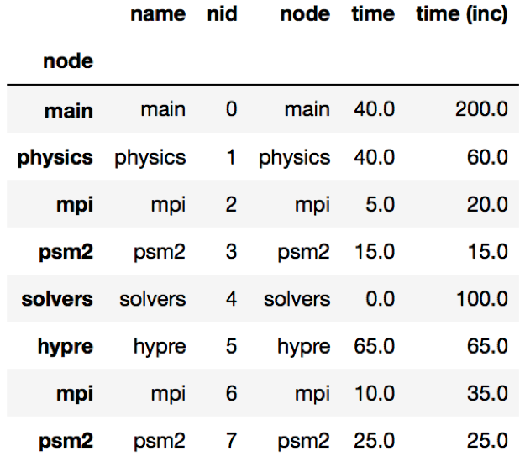

Hatchet’s GraphFrame: a Graph and a Dataframe
Graph: Stores relationships between parents and children
Pandas Dataframe: 2D table storing numerical data associated with each node (may be unique per rank, per thread)

Slide 8

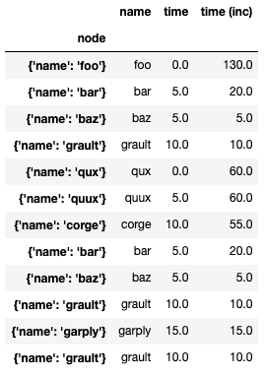
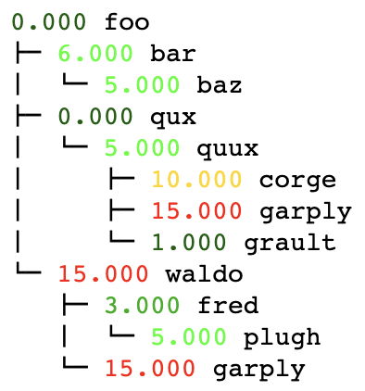
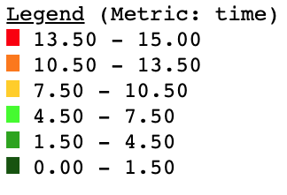
Visualizing Hatchet’s GraphFrame components

Slide 9
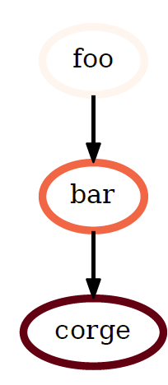
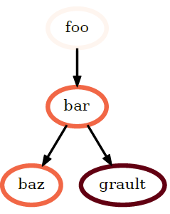
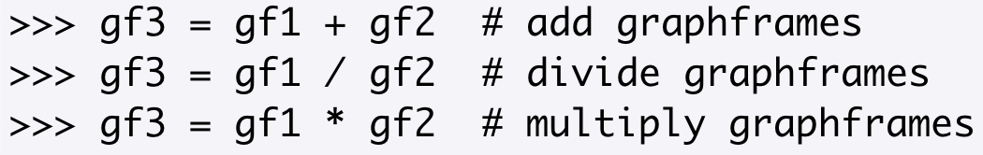
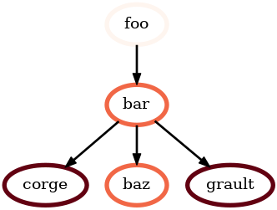
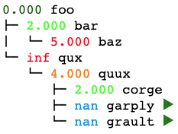
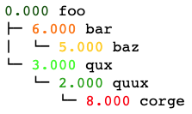
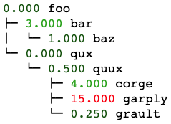

Compare GraphFrames using division (or add, subtract, multiply)
$$∪$$
*First, unify two trees since structure is different
=
gf3
gf1
gf2
=
/

Slide 10
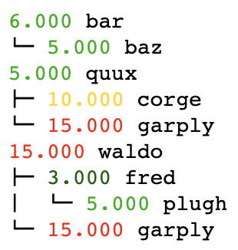

Filter the GraphFrame by node metrics in the dataframe
Keep only those nodes with a value greater than 1

Slide 11
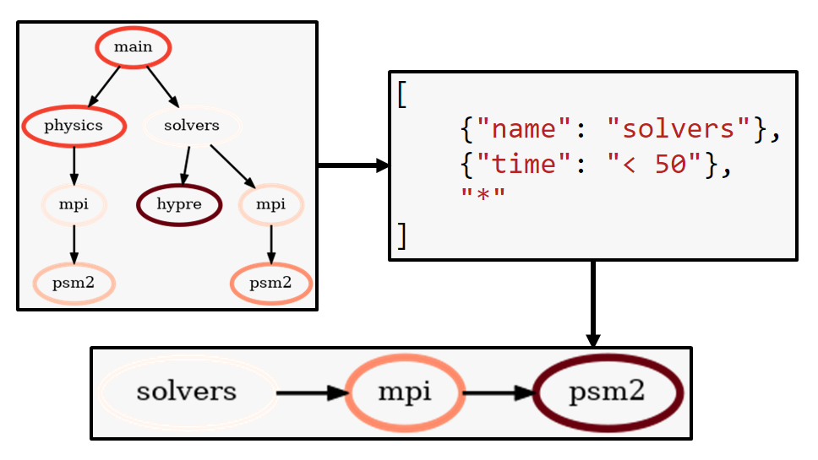
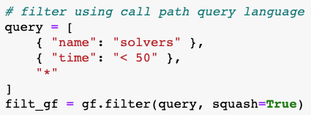

Filter the GraphFrame using Hatchet’s call path query language
Data reduction using call path pattern matching
Call Path Query
Matches a call path (1) rooted at a node with name “solvers”, (2) followed by a node with a time metric value less than 50, and (3) followed by any number of children nodes.

Slide 12
Filter the GraphFrame using Hatchet’s call path query language
Data reduction using call path pattern matching
Call Path Query
Matches a call path (1) rooted at a node with name “solvers”, (2) followed by a node with a time metric value less than 50, and (3) followed by any number of children nodes.

Slide 13
Filter the GraphFrame using Hatchet’s call path query language
Data reduction using call path pattern matching
Call Path Query
Matches a call path (1) rooted at a node with name “solvers”, (2) followed by a node with a time metric value less than 50, and (3) followed by any number of children nodes.

Slide 14
Filter the GraphFrame using Hatchet’s call path query language
Data reduction using call path pattern matching
Call Path Query
Matches a call path (1) rooted at a node with name “solvers”, (2) followed by a node with a time metric value less than 50, and (3) followed by any number of children nodes.

Slide 15

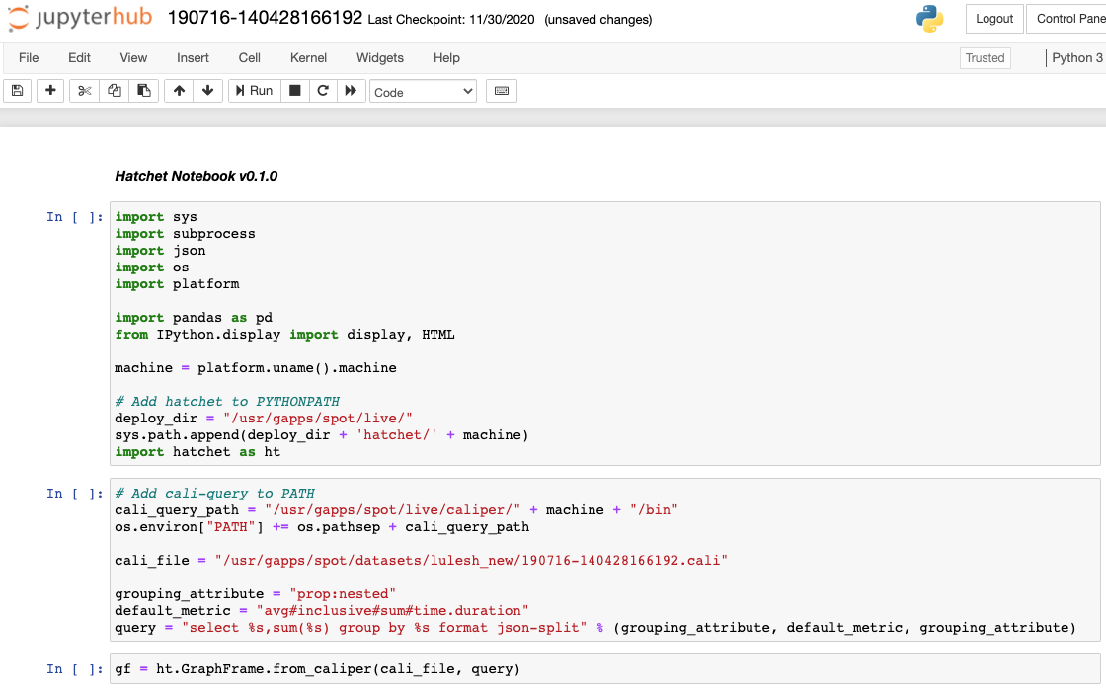
How do I load SPOT/Caliper data into Hatchet?
1. Directory of SPOT/Caliper files
2. Buttons bring up filled-in Jupyter notebook loading 1 or many SPOT/Caliper files
4. Setup cali-query to extract performance data
3. Caliper file(s) to explore
5. Hatchet’s Caliper reader loads into Hatchet’s GraphFrame object

Slide 16
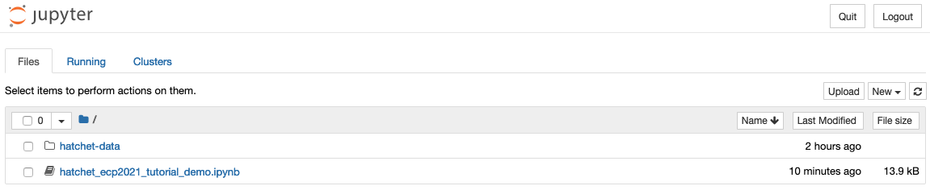
Hands-On Time!
The SPOT container includes a sample Jupyter notebook, Hatchet v1.3.0 install, and Lulesh datasets.
Alternatively, the sample Jupyter notebook and the Lulesh datasets are available directly at https://github.com/llnl/spotbe. This will require you to setup your own environment with a caliper and hatchet install (and setup the paths accordingly in the notebook)!
Following this tutorial, you can substitute your own SPOT/Caliper data files into the example notebook.
Hop over to Jupyter to run the notebook
We’ll be walking through hatchet_ecp2021_tutorial_demo.ipynb

Slide 17
Review: Topics covered in today’s tutorial
Single graph:
Load SPOT/Caliper data file
Visualize tree and dataframe
Filter and squash tree
Subtract two trees:
Load two SPOT/Caliper data files
Compute percent change of two nightly test runs (two different times)
Update existing column in dataframe
Added new column to dataframe
Visualize resulting tree
Speedup of two trees:
Load two SPOT/Caliper data files
Divide two graphs for speedup comparison
Visualize resulting tree
Generate speedup plot for interesting functions
# Read in a SPOT/Caliper file
gf = ht.GraphFrame.from_caliper(
“my-file.cali”,
query,
)
# Divide two trees
gf3 = gf2 / gf1
# Print tree visualization
print(gf.tree(metric_column=“time (inc)”))
# Print dataframe
print(gf.dataframe)
# Diff two trees
gf3 = (gf2 – gf1) / gf1

Slide 18
Readily available features not covered in today’s tutorial
Add or multiply two graphframes
Insert new column to dataframe of metrics
Scale and offset “time” column by some factor: https://hatchet.readthedocs.io/en/latest/advanced_examples.html#applying-scalar-operations-to-attributes
Compute imbalance across MPI ranks within a single application execution: https://hatchet.readthedocs.io/en/latest/advanced_examples.html#applying-scalar-operations-to-attributes
Groupby-and-aggregate nodes by other columns (e.g., function name, file name)
res = gf.groupby_aggregate([“file”], {“time”: np.sum})
For more details, please visit our User Guide: https://hatchet.readthedocs.io/en/latest/user_guide.html

Slide 19
Summary
Hatchet is a performance analysis tool for parallel profiles
It enables programmatic analysis of hierarchical data from one or multiple execution profiles
Future Work:
Support other profile formats, add a format for outputting GraphFrames to disk
Implement a higher-level API for automating performance analysis
Hatchet https://github.com/hatchet/hatchet/
Caliper https://github.com/LLNL/Caliper
SPOT https://github.com/LLNL/spot2_container
Please contact us at
hatchet-help@listserv.umd.edu
or submit GitHub issues for Hatchet questions, issues, or feature requests!

Slide 21
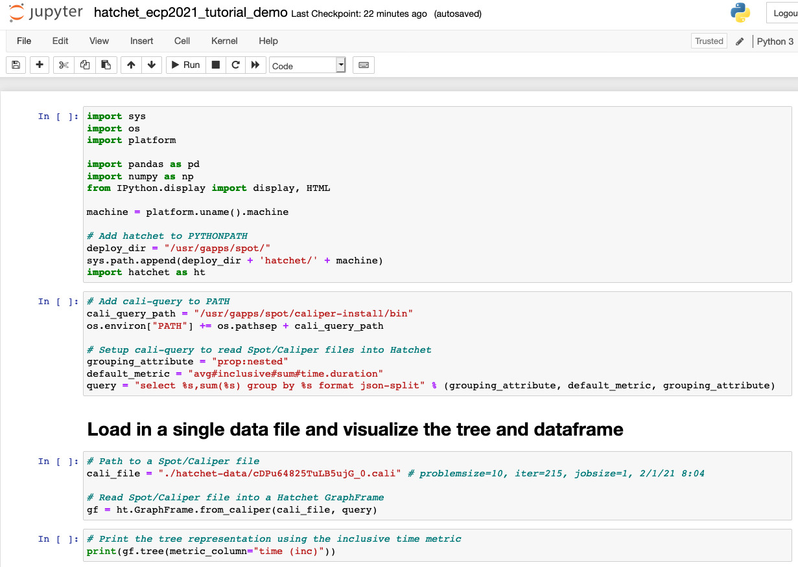
Overview of Hatchet Tutorial Examples
Setup cali-query to extract performance data
Caliper file to explore
Hatchet’s Caliper reader loads into Hatchet’s data object called a GraphFrame
Notes:
Cali-query: Compute sum of default_metric attribute, include all attributes with NESTED flag in grouping, format output in JSON with separate node hierarchy

Slide 22
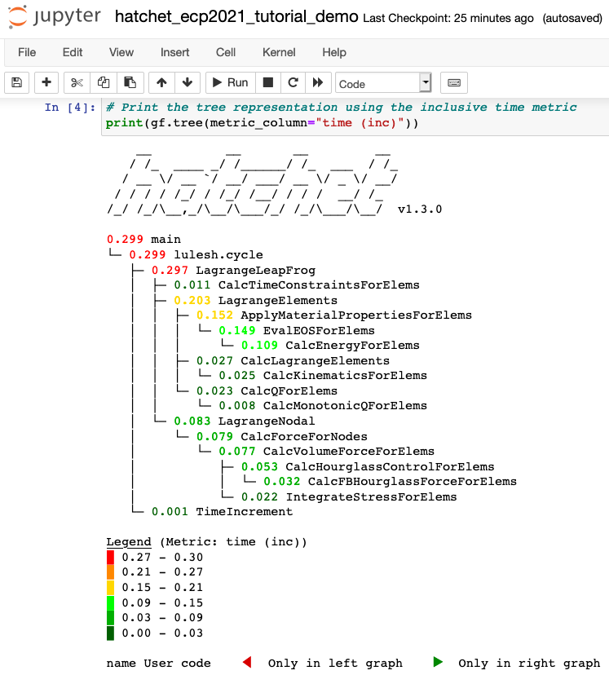
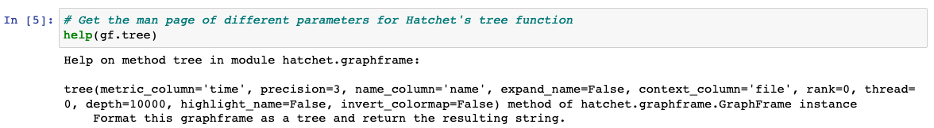
Visualizing the call graph
Each node in the tree visualization maps to a function call in the application
Nodes that are red have high execution time
Nodes highlighted in grey indicate user functions (code from external libraries are not highlighted)

Slide 23
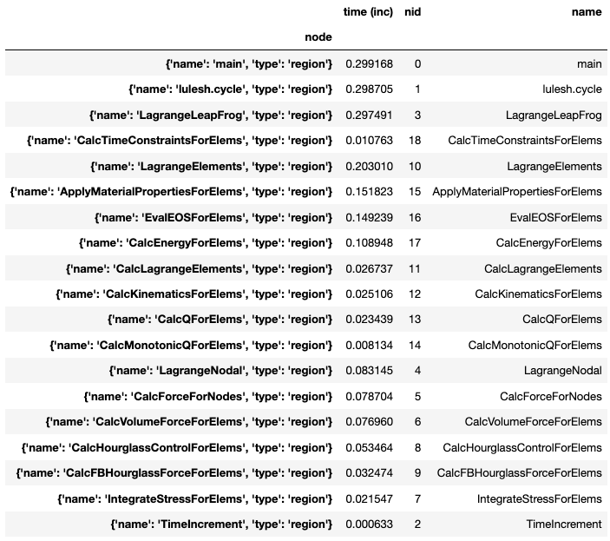
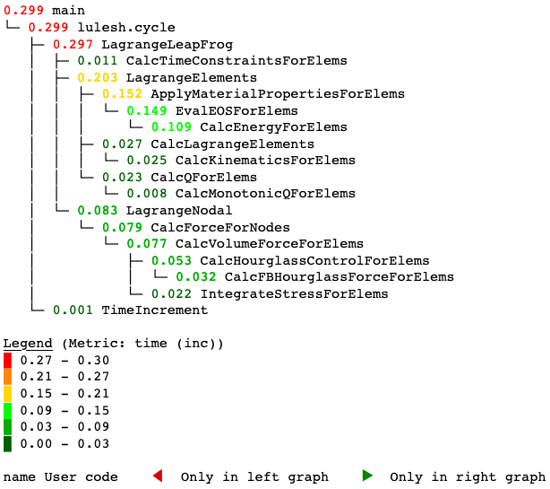
Overview of single tree dataset (Lulesh Data)

Slide 24
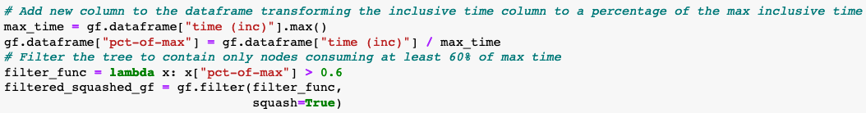
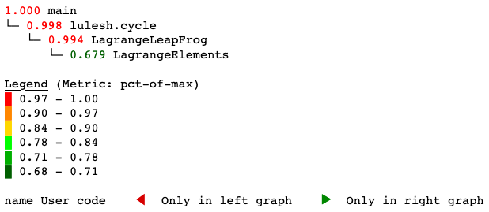
Filtering a tree
Original Graph
Filter graph to keep nodes whose time is greater than 60% of the max time, then rewire graph
Filtered Graph

Slide 25
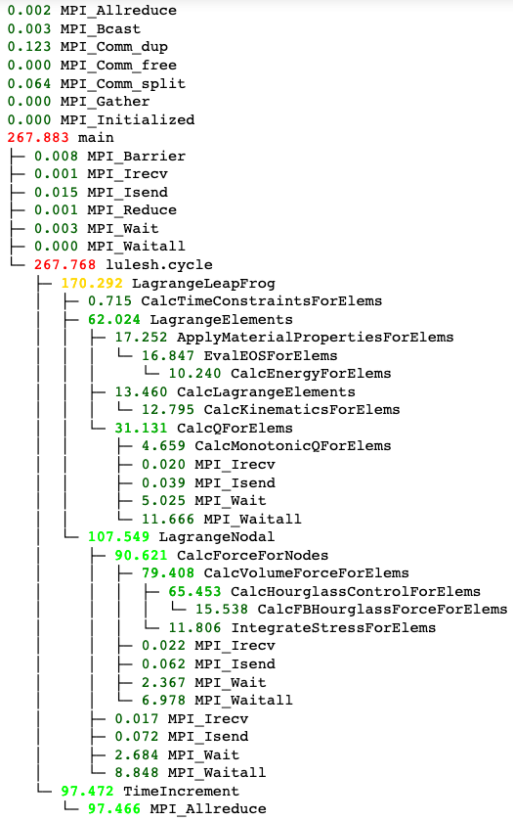
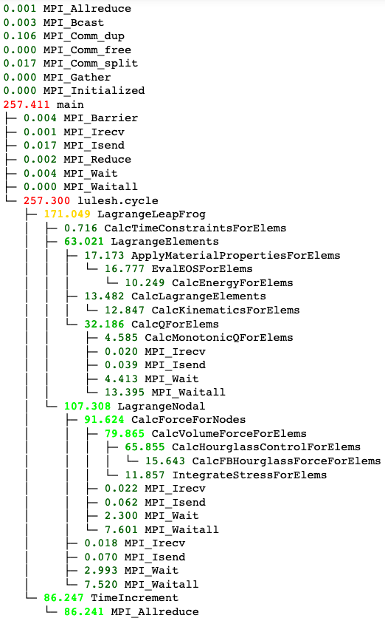
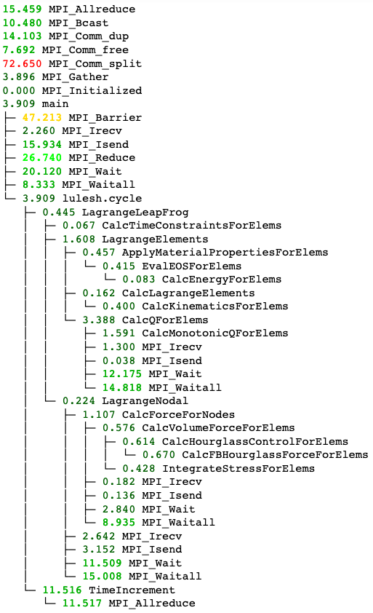
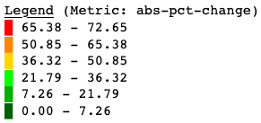
Computing percent change between two trees
gf1
gf2
abs((gf2-gf1)/gf1)

Slide 26
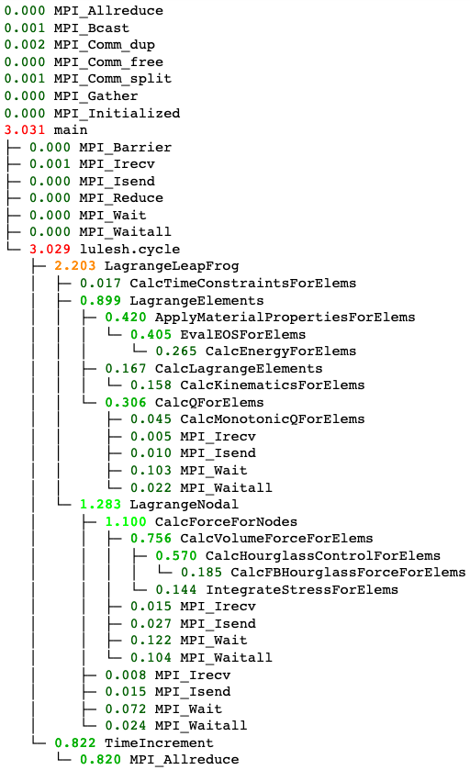
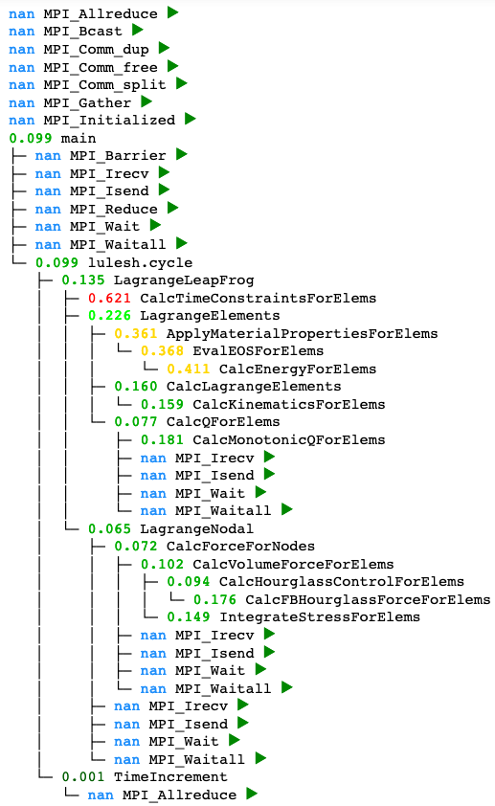
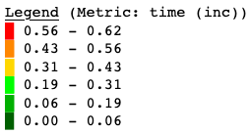
Computing speedup of two trees
1 Rank
64 Ranks
/
=

Slide 27
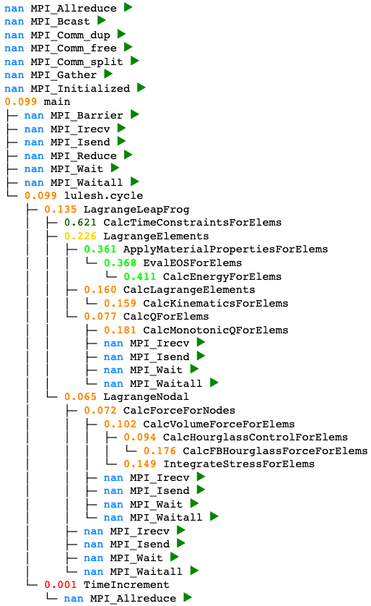
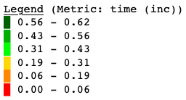
Computing speedup of two trees (invert color scheme of result)
1 Rank
64 Ranks
/
=

Slide 28
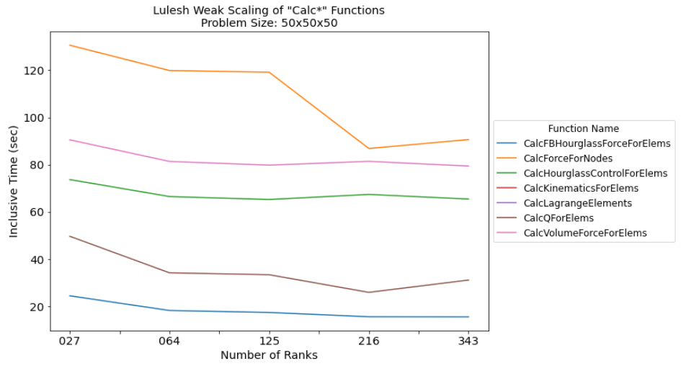
Generate Lulesh weak scaling plot
”Calc*” functions with an inclusive time > 15 sec

